Slide 1
Data Analytics
Yoobee Colleges
Notes:
Make sure how familiar they are with Python?

Slide 2
What is data analytics?
Data analytics is an important field that involves the process of collecting, processing, and interpreting data to uncover insights and help in making decisions.
Data analytics is the practice of examining raw data to identify trends, draw conclusions, and extract meaningful information.
This involves various techniques and tools to process and transform data into valuable insights that can be used for decision-making.

Slide 3
Data Analytics vs Data Science
Data Analytics | Data Science
Data Analyst | Data Scientist
Higher level tools (Excel, Tableau, PowerBI, etc.) | Lower level tools (Programming Languages, Database Systems)
Skills of tools | Knowledge of theories
Medium level of Statistics | High level of Statistics
Well-paid | Higher paid

Slide 4
Types of Data Analytics
Descriptive Analytics
Diagnostic
Analytics
Predictive
Analytics
Prescriptive
Analytics
Cognitive
Analytics
Deals with
What
happened in
the past
Deals with
Why
It happened in the past
Deals with
What Will
happen in the future
Deals with
How
to make it happen
Deals with
Artificial Intelligence

Slide 5
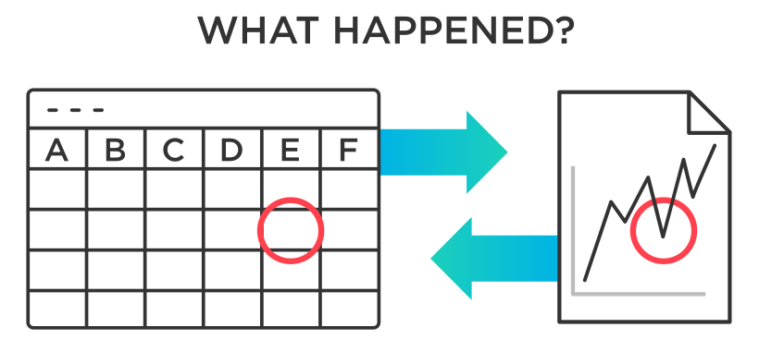
Descriptive Analytics
There are two main techniques used in descriptive analytics:
Data aggregation: Data aggregation is the process of gathering data and presenting it in a summarized format.
Data mining: Data mining is the analysis part. This is when the analyst explores the data in order to uncover any patterns or trends.The outcome of descriptive analysis is a visual representation of the data—as a bar graph, or a pie chart.
Descriptive Analytics
Deals with
What
happened in
the past
—-—-
—-—-
—-—-

Slide 6
Diagnostic Analytics
It provides deeper insights into why specific events, outcomes or behaviours occurred. It aims to reveal the causes that lead to the results.
Define the problem: Clearly define the problem you want to investigate
Data collection: Collect relevant historical data related to the problem
Data preprocessing: Clean the data to ensure the quality and reliability
Statistical analysis: Perform relevant tests
Data visualization: Visualize them to clearly identify their relationships
Anomaly detection: Identify unusual or unexpected patterns in the data
Diagnostic
Analytics
Deals with
Why
It happened in the past

Slide 7
Predictive Analytics
Predictive analytics seeks to predict what is likely to happen in the future.
Based on past patterns and trends, data analysts can utilize predictive models which estimate the likelihood of a future event or outcome.
Machine learning algorithms can be helpful in predictive analysis.
Predictive
Analytics
Deals with
What Will
happen in the future

Slide 8
Prescriptive Analytics
Prescriptive analytics goes beyond what has happened, why it happened, and what might happen in order to determine what should be done next.
Prescriptive models are used to calculate all the possible “routes” a company might take to reach their goals in order to determine the best possible option.
Prescriptive
Analytics
Deals with
How
to make it happen

Slide 9
Cognitive Analytics
Cognitive Analytics combines Artificial Intelligence and Data Analytics to learn from the data and extract the hidden patterns from data. It brings all the data sources.
This data comes from everywhere: sensors used to gather climate information, posts to social media platforms, voices, images and videos, purchase transaction records, and mobile phone GPS signals, etc.
How does Cognitive Analytics work?
Understanding natural language and human interactions.
Generating and evaluating the Evidence-based hypothesis.
Adapting and learning from user selections and responses.
Cognitive
Analytics
Deals with
Artificial Intelligence

Slide 10
Technologies
Data Pre-processing
Python (Numpy, Pandas, etc.)
R
Data visualization
Tableau (https://www.tableau.com/)
Python (Matplotlib, Seaborn, Plotly and Cufflinks, etc.)
R
Machine Learning Algorithms
Linear Regression, Logical Regression, K-means, SVM (support vector machine), Decision Tree, MLP (Multilayer Perceptron)
Deep Learning algorithms (Deep Neural Networks, Transformer, etc.)
Big data and Spark

